Slide 1

Machine Learning with Python
Cheat Sheet
For more information on the functions, see the documentation for:
Numpy (https://numpy.org/doc/2.3/user/absolute_beginners.html)
Pandas (https://pandas.pydata.org/docs/user_guide/index.html#user-guide, https://pandas.pydata.org/Pandas_Cheat_Sheet.pdf)
Scikit-Learn (https://scikit-learn.org/0.21/user_guide.html)
Keras (https://keras.io/guides/sequential_model)

Slide 2
Descriptive Analysis of Numerical Variables
What it is: A first step in data analysis to understand the distribution of variables (mean, min, max, variance, correlations).
When to use it: Always at the beginning of a project — to detect anomalies, missing values, and the relationships between variables.
Example: Examining exam scores to see the average, spread, and whether two subjects are correlated.

Slide 3
Descriptive Analysis of Numerical Variables – python code
import pandas as pd
df = pd.read_csv("data.csv") # , index_col=‘id’ , sep=‘; ‘
display(df.head())
# Basic statistics
display(df.describe())
# Correlation matrix
display(df.corr())
# Missing values
display(df.isnull().sum())
# Separating the features from the value to be predicted (column ‘target’ for example)
X = df.drop(columns=[‘target'])
y = df[‘target']

Slide 4
Cleaning Variables
What it is: Preparing the dataset by fixing or removing incorrect/missing/inconsistent data.
When to use it: Always before training a model. A dirty dataset leads to biased or unusable models.
Example: Replacing missing ages with the average age; converting "Male/Female" into numbers.

Slide 5
Cleaning Variables – python code
Missing values: drop or impute
Categorical encoding
Outliers (optional)
Interquartile Range = Q3 – Q1 → the width of the box in a boxplot.
df = df.dropna()
df["col"].fillna(df["col"].mean(), inplace=True)
df = pd.get_dummies(df, columns=["category"])
q1, q3 = df["col"].quantile([0.25, 0.75])
iqr = q3 - q1
df = df[(df["col"] >= q1-1.5*iqr) & (df["col"] <= q3+1.5*iqr)]

Slide 6
Standardization
What it is: Transforming variables so they all have the same scale (mean=0, std=1).
When to use it: Needed when models are sensitive to variable scales (SVM, Logistic Regression, kNN, Neural Networks). Not needed for tree-based models (Decision Trees, Random Forest).
Example: If "Income" goes from 0–100,000 and "Age" from 0–100, models might give too much importance to income.

Slide 7
Standardization – python code
from sklearn.preprocessing import Standard
Scalerscaler = StandardScaler()
X_scaled = scaler.fit_transform(X)

Slide 8
Train-Test Split
What it is: Separating data into training (to build the model) and testing (to evaluate performance).
When to use it: Always — to avoid overfitting and check generalization.
Example: 80% of patients’ data to train a diagnostic model, 20% to test predictions.

Slide 9
Train-Test Split – python code
from sklearn.model_selection import train_test_split
X_train, X_test, y_train, y_test = train_test_split( X, y, test_size=0.2, random_state=42, stratify=y
)

Slide 10
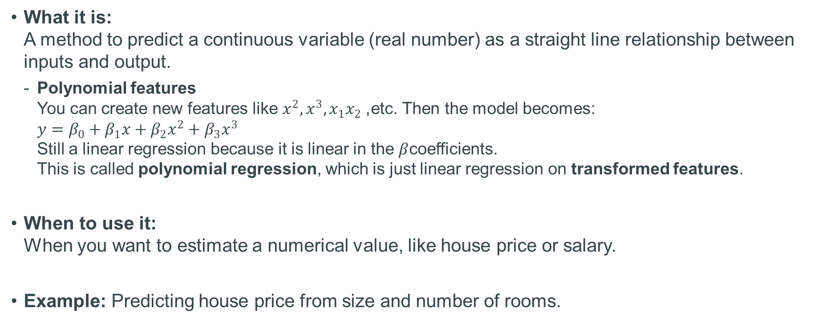
Linear Regression
What it is: A method to predict a continuous variable (real number) as a straight line relationship between inputs and output.
Polynomial features You can create new features like $x^{2},x^{3},x_{1}x_{2}$, etc. Then the model becomes: $y=β_{0}+β_{1}x+β_{2}x^{2}+β_{3}x^{3}$ Still a linear regression because it is linear in the $β$coefficients. This is called polynomial regression, which is just linear regression on transformed features.
When to use it: When you want to estimate a numerical value, like house price or salary.
Example: Predicting house price from size and number of rooms.

Slide 11
Linear Regression – python code
from sklearn.linear_model import Linear
Regressionmodel = LinearRegression()
model.fit(X_train, y_train)
y_pred = model.predict(X_test)
Documentation:
https://scikit-learn.org/stable/modules/generated/sklearn.linear_model.LinearRegression.html

Slide 12
Logistic Regression
What it is: Despite the name, it’s for classification, not regression. It estimates the probability of belonging to a class.
When to use it: When the target is binary (yes/no, 0/1). Multinomial logistic regression: generalizes to more than 2 categories:
It uses one of two strategies:
One-vs-Rest (OvR) (default in scikit-learn)
Train 1 model per class vs. all other classes.
Choose the class with the highest probability.
Multinomial (softmax regression)
A single model that directly computes probabilities for all classes at once.
Often better when classes are not linearly separable.
Example: Predicting if an email is spam (1) or not spam (0).

Slide 13
Logistic Regression – python code
from sklearn.linear_model import LogisticRegression
model = LogisticRegression(max_iter=1000)
# If more than 2 categories
# model = LogisticRegression(multi_class="multinomial", solver="lbfgs", max_iter=200)
model.fit(X_train, y_train)
y_pred = model.predict(X_test)
Documentation:
https://scikit-learn.org/stable/modules/generated/sklearn.linear_model.LogisticRegression.html

Slide 14
Support Vector Machine (SVM)
What it is: A classification method that finds the “best boundary” (hyperplane) between classes. You can use different types of boundaries
When to use it: Effective in small/medium datasets with clear separation.
Example: Classifying images of cats vs. dogs.
Kernel | Shape of Boundary | When to Use
Linear | Straight line / hyperplane | Data is linearly separable
Polynomial | Curved, polynomial-shaped | Data has feature interactions
RBF (Gaussian) | Flexible, curved | Default choice for most problems
Sigmoid | Neural network-like | Rare, experimental use

Slide 15
Support Vector Machine – python code
from sklearn.svm import SVC
model = SVC(kernel="rbf")
model.fit(X_train, y_train)
y_pred = model.predict(X_test)
Documentation:
https://scikit-learn.org/stable/modules/generated/sklearn.svm.SVC.html

Slide 16
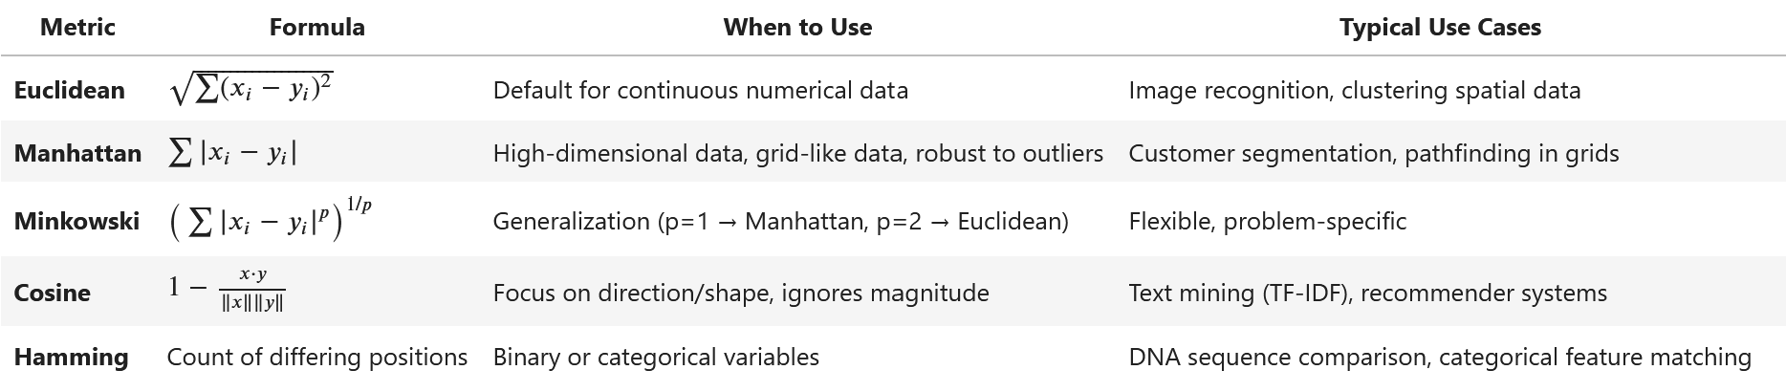
k-Nearest Neighbors (kNN)
What it is: Classifies a point by looking at the labels of its nearest neighbors in the dataset. You can use different metric:
When to use it: Good for simple classification problems with small datasets.
Example: Predicting if a fruit is apple or orange based on size and color.

Slide 17
k-Nearest Neighbors – python code
from sklearn.neighbors import KNeighborsClassifier
model = KNeighborsClassifier(n_neighbors=5, metric="minkowski", p=2)
model.fit(X_train, y_train)
y_pred = model.predict(X_test)
Documentation:
https://scikit-learn.org/stable/modules/generated/sklearn.neighbors.KNeighborsClassifier.html

Slide 18
Decision Tree
What it is: A model that splits data by asking questions (like a flowchart).
When to use it: When interpretability is important.
Example: Deciding if someone should get a loan based on income and credit history.

Slide 19
Decision Tree – python code
from sklearn.tree import DecisionTree
Classifiermodel = DecisionTreeClassifier(max_depth=5, random_state=42)
model.fit(X_train, y_train)
y_pred = model.predict(X_test)
Documentation:
https://scikit-learn.org/stable/modules/generated/sklearn.tree.DecisionTreeClassifier.html

Slide 20
Random Forest
What it is: An ensemble of many decision trees, combining their predictions for better accuracy.
When to use it: A strong default model for many classification/regression tasks.
Example: Predicting customer churn in telecom data.

Slide 21
Random Forest – python code
from sklearn.ensemble import RandomForestClassifier
model = RandomForestClassifier(n_estimators=100, random_state=42)
model.fit(X_train, y_train)
y_pred = model.predict(X_test)
Documentation:
https://scikit-learn.org/stable/modules/generated/sklearn.ensemble.RandomForestClassifier.html

Slide 22
KMeans (Unsupervised Learning)
What it is: Groups data into clusters without knowing labels.
When to use it: When you want to discover natural groupings in data.
Example: Grouping customers into 3 market segments.

Slide 23
KMeans– python code
from sklearn.cluster import Kmeans
import numpy as np
from scipy.stats import mode
kmeans = KMeans(n_clusters=3, random_state=42)
clusters = kmeans.fit_predict(X)
# Optional: map clusters to labels (if ground truth exists)
import numpy as np
from scipy.stats import mode
labels = np.zeros_like(clusters)
for i in range(3):
labels[clusters == i] = mode(y[clusters == i])[0]
Documentation:
https://scikit-learn.org/stable/modules/generated/sklearn.cluster.KMeans.html

Slide 24
Simple Feedforward Neural Network
What it is: A model inspired by the brain, made of layers of neurons.
When to use it: When relationships are complex and non-linear, especially with large datasets.
Example: Handwritten digit recognition (MNIST).

Slide 25
Simple Feedforward Neural Network – python code
from tensorflow.keras.models import Sequential
from tensorflow.keras.layers import Dense
model = Sequential([
Dense(32, activation="relu", input_shape=(X_train.shape[1],)),
Dense(16, activation="relu"),
Dense(1, activation="sigmoid")])
# or Dense(len(unique_classes), activation='softmax’)) for multi-classes examples
model.compile(optimizer="adam", loss="binary_crossentropy", metrics=["accuracy"])
# or loss='sparse_categorical_crossentropy’ for example
model.fit(X_train, y_train, epochs=20, batch_size=32)
Documentation:
https://www.tensorflow.org/guide/keras/sequential_model?hl=en

Slide 26
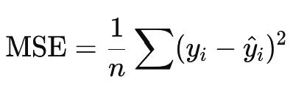
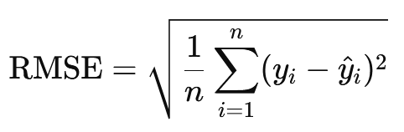
Quality Measures
Regression
R²: proportion of variance explained.
RMSE: how far predictions are from actual values.
Classification
Accuracy: % correctly classified.
Precision/Recall: how many positive predictions are correct / how many real positives detected.
F1 Score: balance between precision and recall.
Confusion Matrix: breakdown of correct vs. incorrect predictions

Slide 27
Quality Measures – python code
from sklearn.metrics import accuracy_score, f1_score, confusion_matrix, r2_score, mean_squared_error
# Regression
print("R²:", r2_score(y_test, y_pred))
print("RMSE:", mean_squared_error(y_test, y_pred, squared=False))
# Classification
print("Accuracy:", accuracy_score(y_test, y_pred))
print("F1:", f1_score(y_test, y_pred, average="weighted"))
print("Confusion matrix:\n", confusion_matrix(y_test, y_pred))
Documentation:
https://scikit-learn.org/stable/modules/model_evaluation.html

